Slide 1

INTERNET OF THINGS
Connecting Smart Objects
Dr. Nagegowda K S
Department of Computer Science & Engineering

Slide 2

INTERNET OF THINGS
Chapter4:Connecting Smart Objects
Dr. Nagegowda K S
Department of Computer Science & Engineering

Slide 3
INTERNET OF THINGS
Agenda
Communication Criteria
IoT Access Technologies

Slide 4
INTERNET OF THINGS
IoT Access Technologies
Standardization and alliances
Physical layer
MAC layer
Topology
Security
Competitive technologies

Slide 5
INTERNET OF THINGS
IoT Access Technologies- IEEE 802.15.4
Home and building automation
Automotive networks
Industrial wireless sensor networks
Interactive toys and remote controls
ZigBee
6LoWPAN
ZigBee IP
ISA100.11a
WirelessHART
Thread

Slide 6
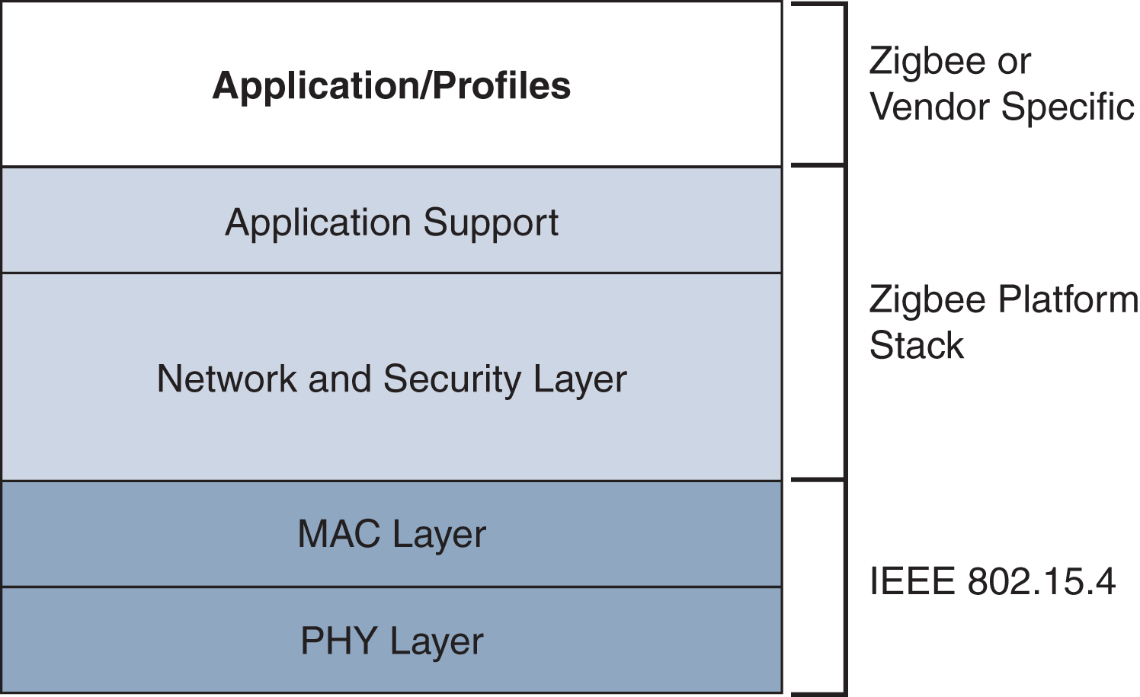
INTERNET OF THINGS
IoT Access Technologies- ZigBee
Figure - High-Level ZigBee Protocol Stack

Slide 7
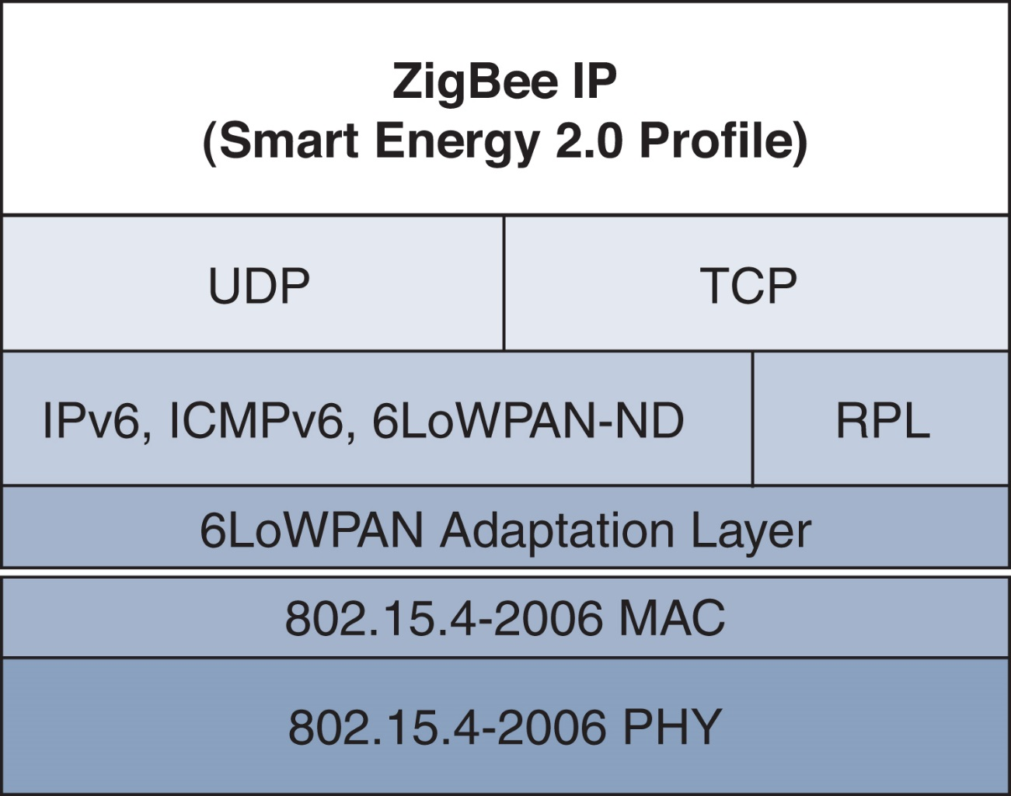
INTERNET OF THINGS
IoT Access Technologies- ZigBee IP
Figure - ZigBee IP Protocol Stack

Slide 8
INTERNET OF THINGS
IoT Access Technologies- Zigbee Physical Layer
2.4 GHz , 16 channels, with a data rate of 250kbps
915 MHz, 10 channels with a date rate of 40kbps
868 MHz, 1 channels with a date rate of 20kbps

Slide 9
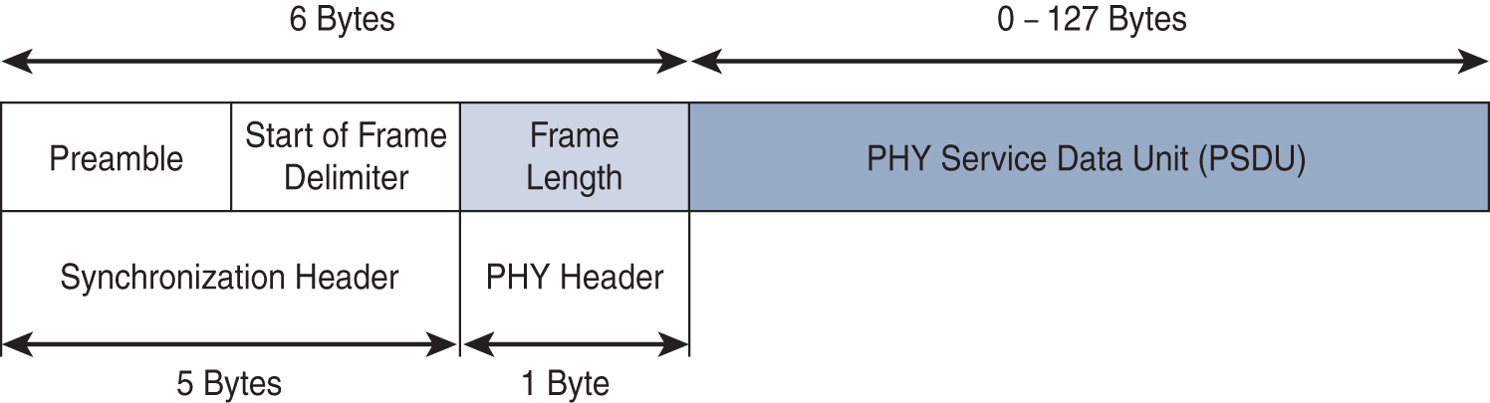
INTERNET OF THINGS
IoT Access Technologies- Zigbee Physical Layer
Figure - IEEE 802.15.4 PHY Format

Slide 10
INTERNET OF THINGS
IoT Access Technologies- ZigBee MAC Layer
The 802.15.4 MAC layer performs the following tasks:
Network beaconing for devices acting as coordinators (New devices use beacons to join an 802.15.4 network)
PAN association and disassociation by a device
Device security
Reliable link communications between two peer MAC entities

Slide 11
INTERNET OF THINGS
IoT Access Technologies- ZigBee MAC Layer
The MAC layer achieves these tasks by using various predefined frame types. In fact, four types of MAC frames are specified in 802.15.4:
Data frame: Handles all transfers of data
Beacon frame: Used in the transmission of beacons from a PAN coordinator
Acknowledgement frame: Confirms the successful reception of a frame
MAC command frame: Responsible for control communication between devices

Slide 12
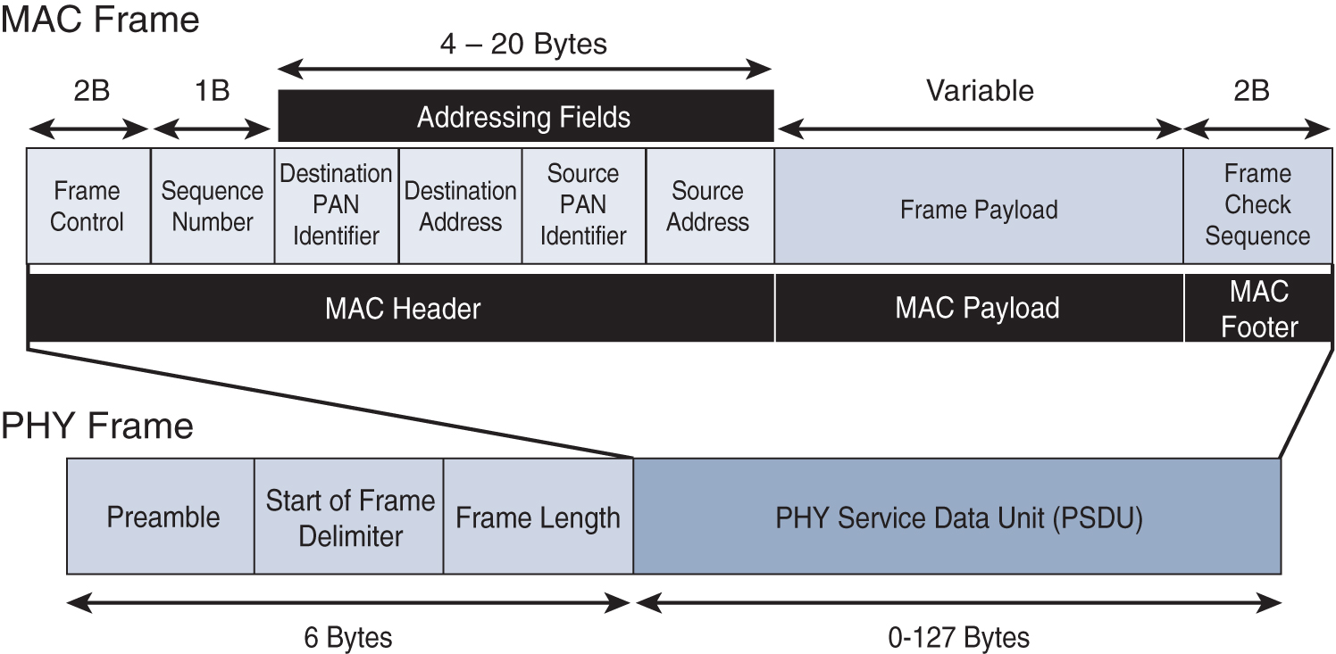
INTERNET OF THINGS
IoT Access Technologies- ZigBee MAC Layer
Figure - IEEE 802.15.4 MAC Format

Slide 13
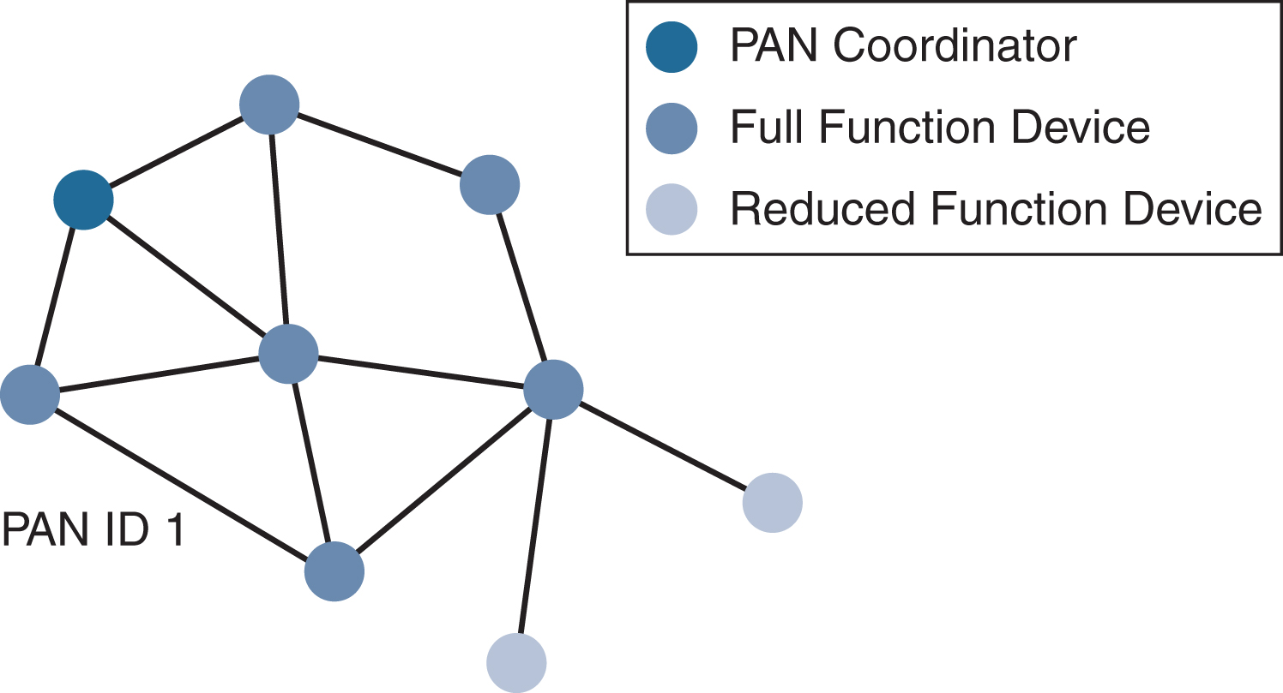
INTERNET OF THINGS
IoT Access Technologies- ZigBee Topology
Figure - 802.15.4 Sample Mesh Network Topology

Slide 14
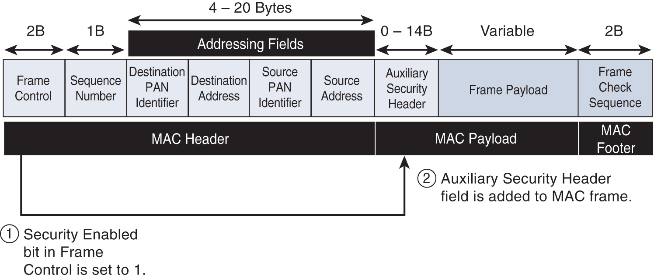
INTERNET OF THINGS
IoT Access Technologies- ZigBee Security
Figure - Frame Format with the Auxiliary Security Header Field for 802.15.4-2006 and Later Versions

Slide 15
INTERNET OF THINGS
IoT Access Technologies- IEEE 802.15.4g and 802.15.4e
Distribution automation and industrial supervisory control and data acquisition (SCADA) environments for remote monitoring and control
Public lighting
Environmental wireless sensors in smart cities
Electrical vehicle charging stations
Smart parking meters
Microgrids
Renewable energy

Slide 16
INTERNET OF THINGS
IoT Access Technologies- IEEE 802.15.4g and 802.15.4e
MAC Layer:
Time-Slotted Channel Hopping- TSCH
Information Elements
Enhanced beacons
Enhanced beacons requests
Enhanced Acknowledgement

Slide 17
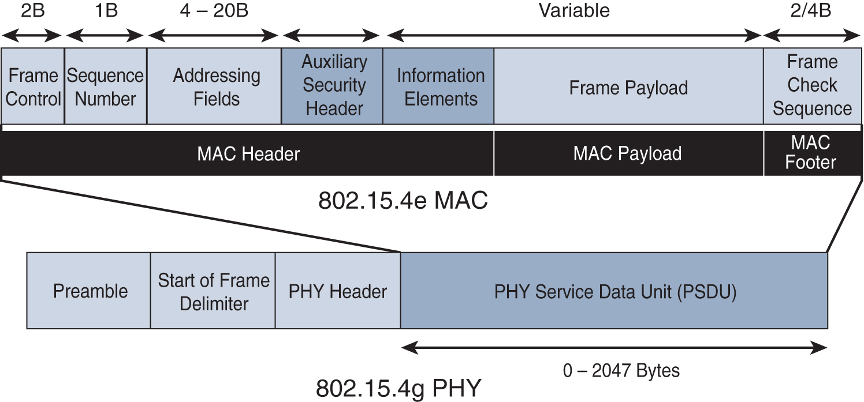
INTERNET OF THINGS
IoT Access Technologies- IEEE 802.15.4g and 802.15.4e
Figure - IEEE 802.15.4g/e MAC Frame Format

Slide 18
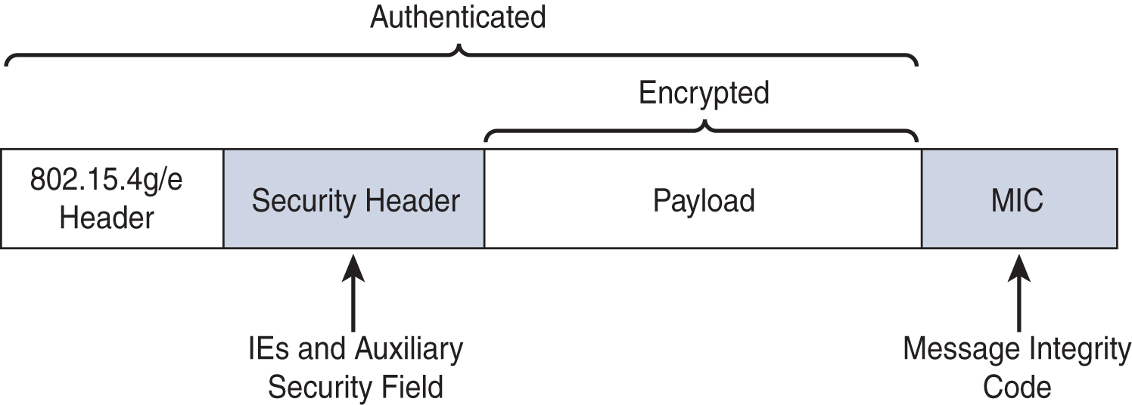
INTERNET OF THINGS
IoT Access Technologies- IEEE 802.15.4g and 802.15.4e
Figure - IEEE 802.15.4g/e MAC Layer Security

Slide 19
INTERNET OF THINGS
IoT Access Technologies- IEEE 1901.2a
Smart metering
Distribution automation
Public lighting
Electric vehicle charging stations
Microgrids
Renewable energy

Slide 20
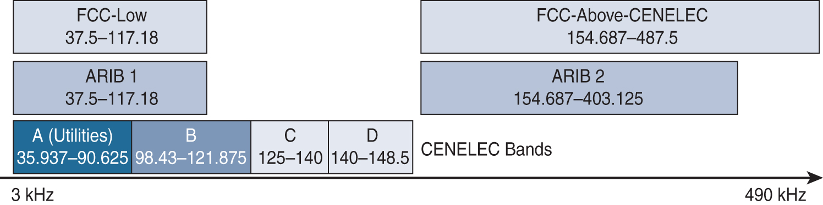
INTERNET OF THINGS
IoT Access Technologies- IEEE 1901.2a PHY
Figure - NB-PLC Frequency Bands

Slide 21
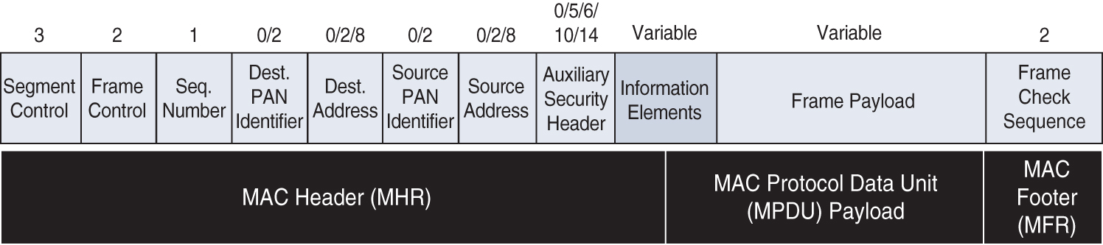
INTERNET OF THINGS
IoT Access Technologies- IEEE 1901.2a MAC

Slide 22
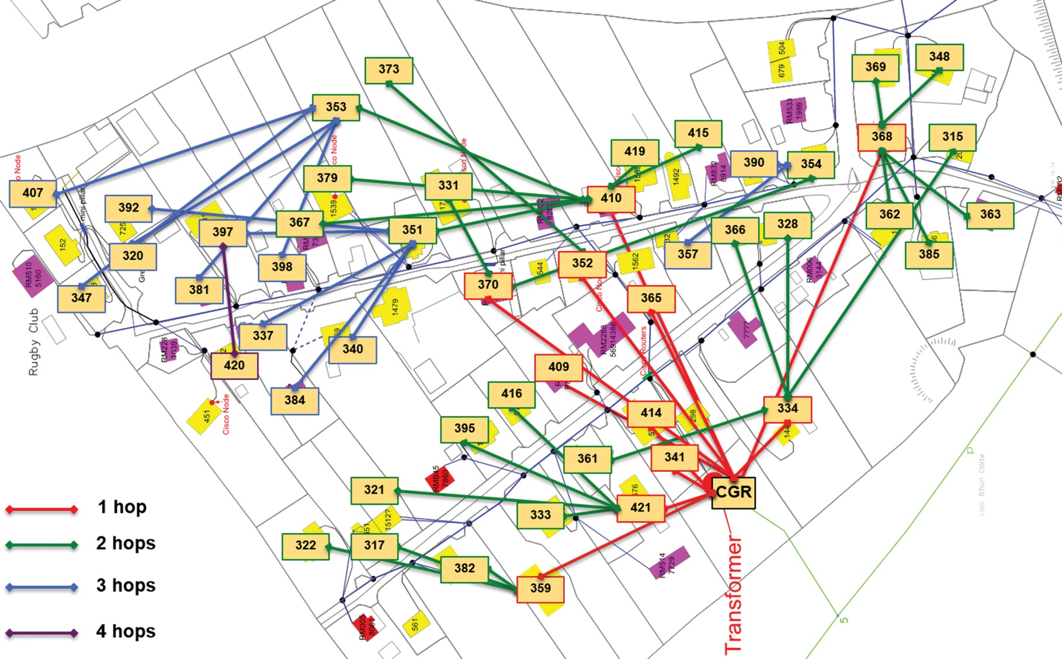
INTERNET OF THINGS
IoT Access Technologies- IEEE 1901.2a Topology

Slide 23
INTERNET OF THINGS
IoT Access Technologies- IEEE 802.11ah
Sensors and meters covering a smart grid
Backhaul aggregation of industrial sensors and meter data
Extended range Wi-Fi

Slide 24
INTERNET OF THINGS
IoT Access Technologies- IEEE 802.11ah MAC
Number of devices
MAC header
Null data packet support
Grouping and sectorization
Restricted access window
Target wake time
Speed frame exchange

Slide 25
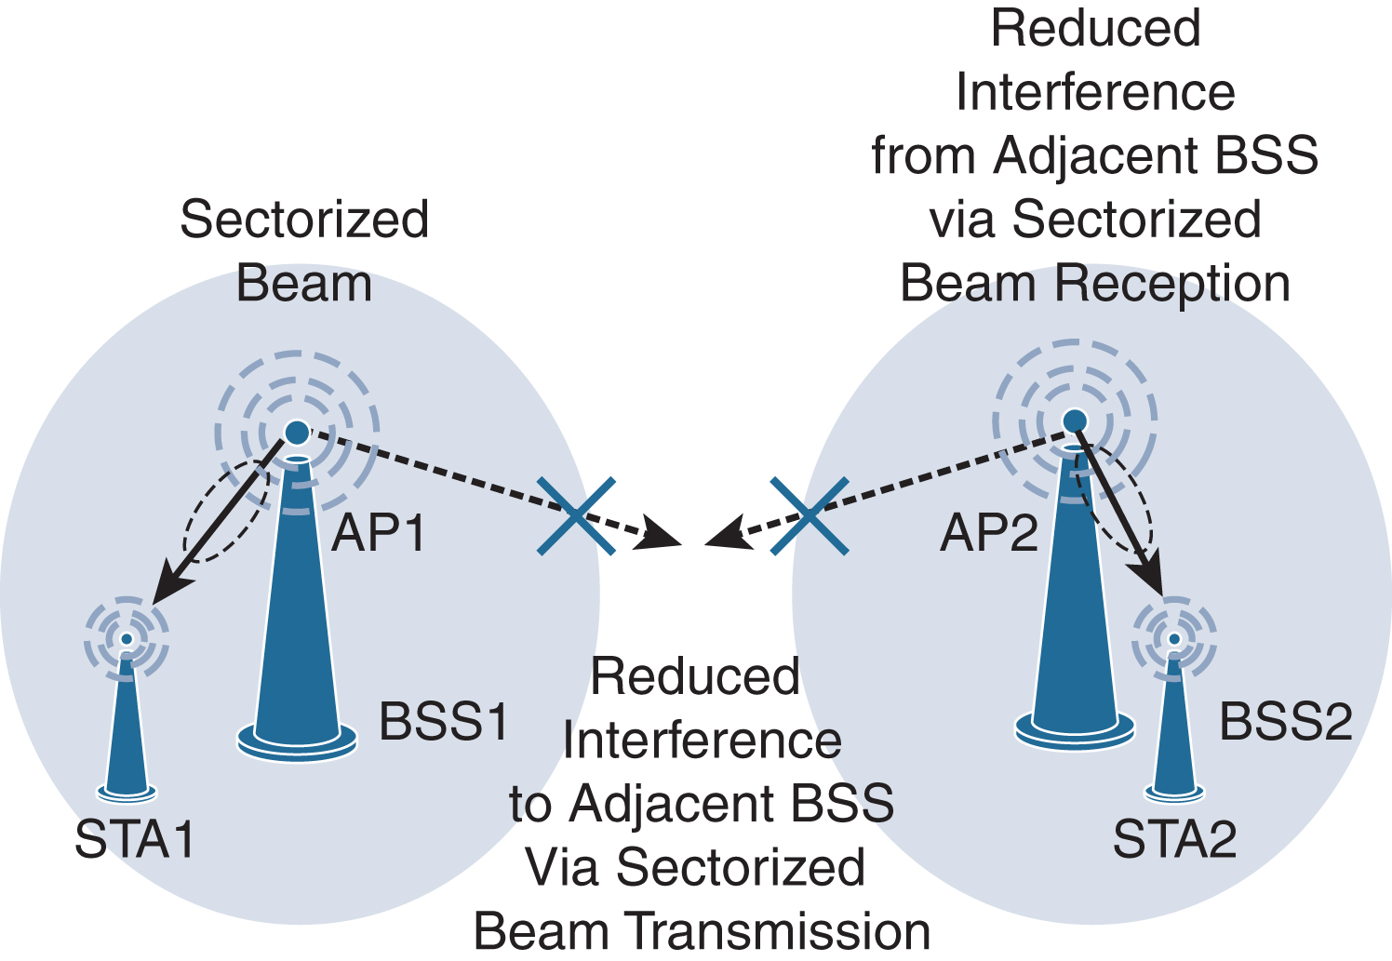
INTERNET OF THINGS
IoT Access Technologies- IEEE 802.11ah Topology

Slide 26
THANK YOU
Dr. Nagegowda K S
Department of Computer Science & Engineering
nagegowda@pes.edu

